Slide 1
How Getting Involved In The Community Changed My Life
#ICC14

Slide 2
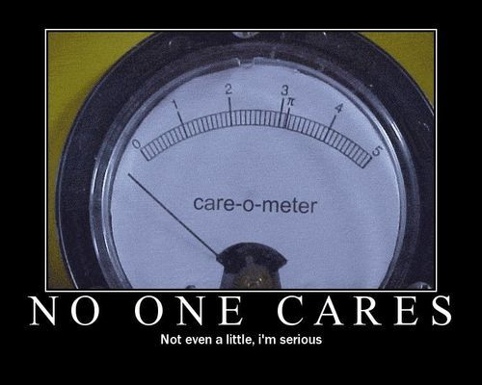
Who Am I?
Mike Cole
@colemike
http://colemike.com
Software Developer for ClickPoint Software in Scottsdale, AZ
Work remotely from Cedar Falls

Slide 3
Who was I? (circa 7 years ago)
I was a cubicle dweller waiting for 5:00 so I could go home and play WoW.
Spent at least 1 hour daily talking to a coworker about video games, TV, etc.
Self proclaimed hotshot because I could write stored procedures and drag controls onto a designer.
Had an MCTS study guide book displayed prominently on my desk because I was going to get Microsoft Certified.
If I played my cards right, I could become a Project Manager someday! (the dream?)
No real expectations were put on me, no peers, no clue.

Slide 4
What Happened?
We hired some consultants. I finally had peers!
Have you thought about solving your problem this way?
Last night I read about…
You’re still using VSS?
CVINETA User Group started
Made me feel overwhelmed and inadequate. “I’m really terrible at what I do.”
Met professional idols.
Changed my perspective
Embraced “lifelong learning” aspect of what we do.
Confidence
I started to use the new technologies that I was learning.
I began to understand higher level concepts such as software craftsmanship, agile development, clean code, and SOLID principles.

Slide 5
How have I changed?
CVINETA officer for past 5 years
Spoken at several user groups in the area
Recently accepted a senior level developer position where I’m constantly challenged and learning new things (the real dream!)
Try to blog
Try to contribute to OSS
Moderate amount of rep on Stack Overflow
Curious mind (play around with random things like Chocolatey and Jekyll for fun)
KEY POINT: I make an effort to help, to teach, to learn, to give back.

